Slide 1
Fingerprints
Medical Detectives – CSI Basics

Slide 2
What is a fingerprint?
Ridges on the skin of your fingers
Everyone’s fingerprints are different!
Fingerprints are the same for your whole life!
Fingerprints have general patterns that allow them to be classified and studied.
All fingerprints are classified into 3 categories – Arches, Loops, Whorls.

Slide 3
Arches!
Ridges enter on one side and exit on the other side
Approximately 6% of people have this pattern
This picture is of a Plain Arch

Slide 4
Tented Arches!
Ridges enter on one side and exit on the other side
Approximately 6% of people have this pattern
This print has a spike of arches in the center

Slide 5
Did You Know?
Dactyloscopy is the study of fingerprint identification. Police investigators are experts in collecting “dactylograms”, otherwise known as fingerprints.

Slide 6
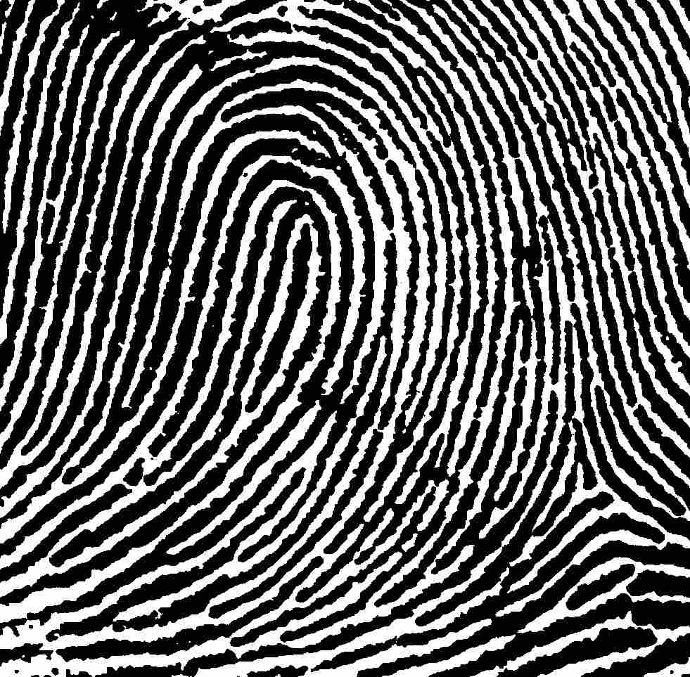
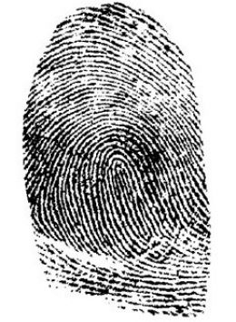
Loops!
Ridges enter on one side and exit on the SAME side.
Approximately 60% of people have loops
Top image is a Left Loop
Bottom Image is a Right Loop

Slide 7
Central Pocket Loops!
Ridges enter on one side and exit on the SAME side
Loops that do NOT lean to one side or the other are Pocket Loops

Slide 8
Double Loops!
Ridges enter on one side and exit on the SAME side
When two loops form an S shape in the center we call them Double Loops

Slide 9
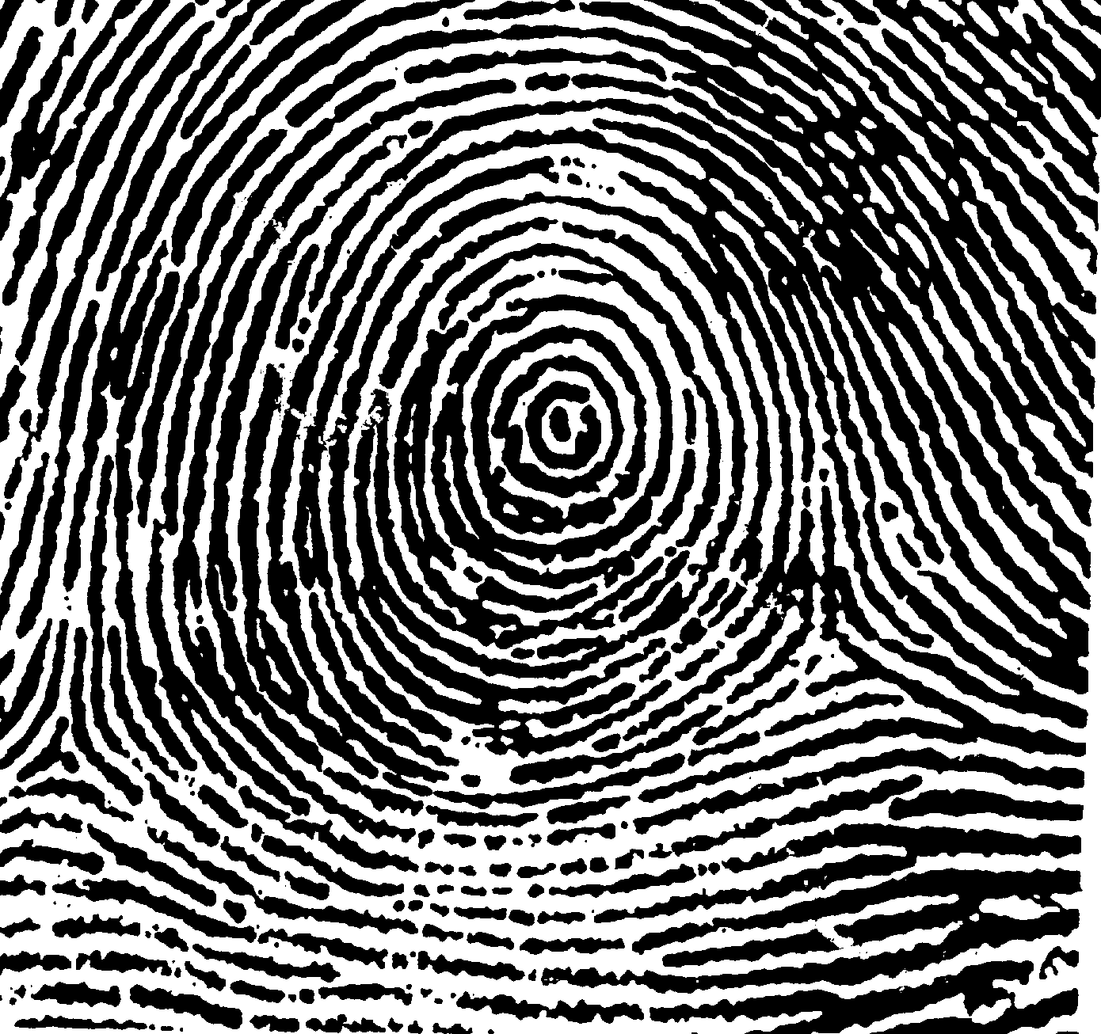
Whorls!
Ridges are circles, or spirals
Approximately 34% of people have loops
This is a plain Central Whorl

Slide 10
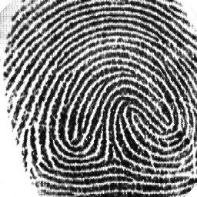
Accidental Whorls!
Ridges are two sets of circles, or spirals
These whorls seem to blend together in the center
This is an example of an Accidental Whorl

Slide 11
Ridge Details!
When we examine fingerprints we use a magnifying glass or microscope
We try to identify the different kinds of ridge details, so as to match a specific print to an exemplar.

Slide 12
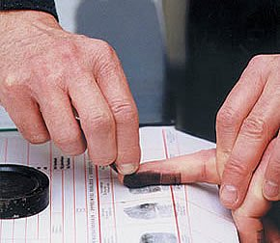
To Take Prints…
1st – Roll the “pad” portion of your thumb over the ink pad from the left side of your thumb to the right. You do not have to push down really hard!
2nd – Roll the “pad” portion of your thumb from the left side of your thumb to the right in the correct box on your paper to make a thumbprint.

