Slide 1
Wetlands
Write many, varied, unusual words to describe each of the following images.

Slide 5
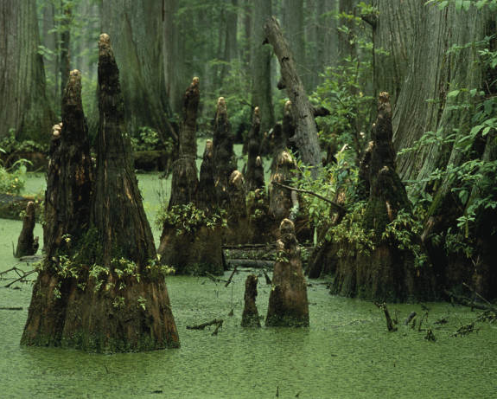
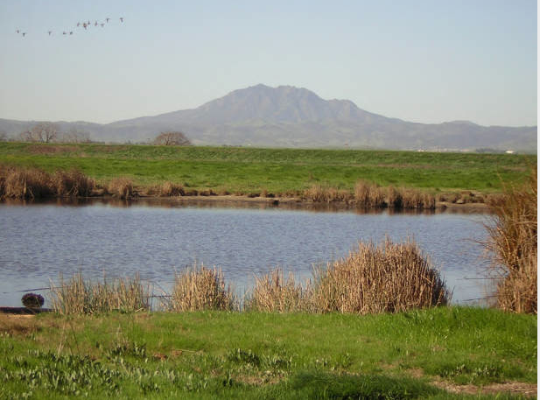
Compare/Contrast the images.

